Slide 1



ABAP on Hana s/4 Hana Training
Day 15
contact@anubhavtrainings.com

Slide 2

Agenda – Day 15
Hierarchy CDS Programming with Tree Table
New Hierarchy
Classical Hierarchy
Implementation of End to End Hierarchy Scenario
Flow of Employee Manager Hierarchy
Describing Functional Information of Hierarchy
Create Fiori App on Top of CDS View
New Hierarchy

Slide 3
CDS Hierarchy
The CDS view provides a list of hierarchies which is known the hierarchy directory for this node view. Every single node belongs to exactly one hierarchy, which can identified by one or multiple key fields of the node view.
A hierarchy can have multiple root nodes.
Hierarchies allows to traverse data faster
They clearly explain the inter-relation between multiple object
Very helpful determining the parent child relationship
0..*
Hierarchy
1 1..*
Node
0..1
0..*
0..1 per Hierarchy
0.1
Business
Entity

Slide 4
Types of Hierarchy
There are Two types of Hierarchy
Creating Using Annotations
Creating by syntax
CDS Hierarchy
New Hierarchy
Classical Hierarchy

Slide 5
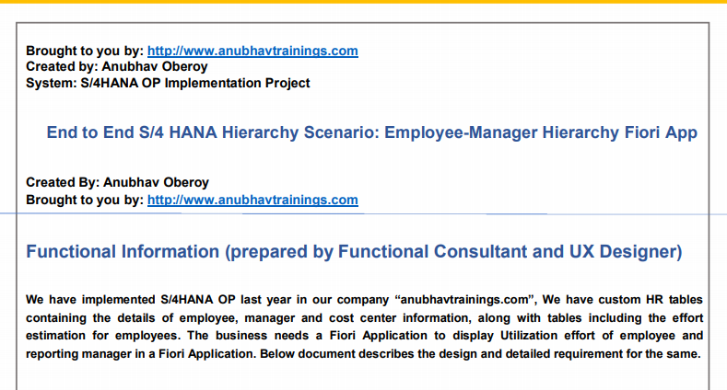
End to End Classical Hierarchy Scenario

Slide 6
Flow of CDS Views in Hierarchy
Consumption CDS View.
Composite CDS View.
Interface CDS View.
Basic CDS View.
ZATS_P_EMPLOYEE
ZATS_I_EMPMGR
ZATS_CO_EMPHOURS
ZATS_C_EMPHOURS

Slide 7
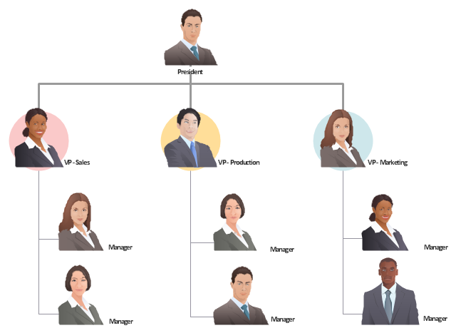
Exercise
CDS Hierarchy Scenario

Slide 8

When to go Free style v/s Fiori Element

Slide 9

End to End Flow of Creating Fiori App
Fiori App Development – Fiori Developer
After Creating CDS View we start SAP Business Application Studio
We Create a Fiori App, Choose Find Command → Fiori : Application Generator
Choose Free Style Fiori app, Enter the App name and the view name
Choose Radio Button Add Deployment Configuration to Yes
Go to view->Main.view.xml, Refer SAPUI5 sdk and create smart filter, smart table and a tree table control
Go to manifest.json and link a new annotation file
Create the annotation file with lineItem annotation to add columns to our table
Go to Run configuration and test the fiori app by connecting to the destination and UI5

Slide 10
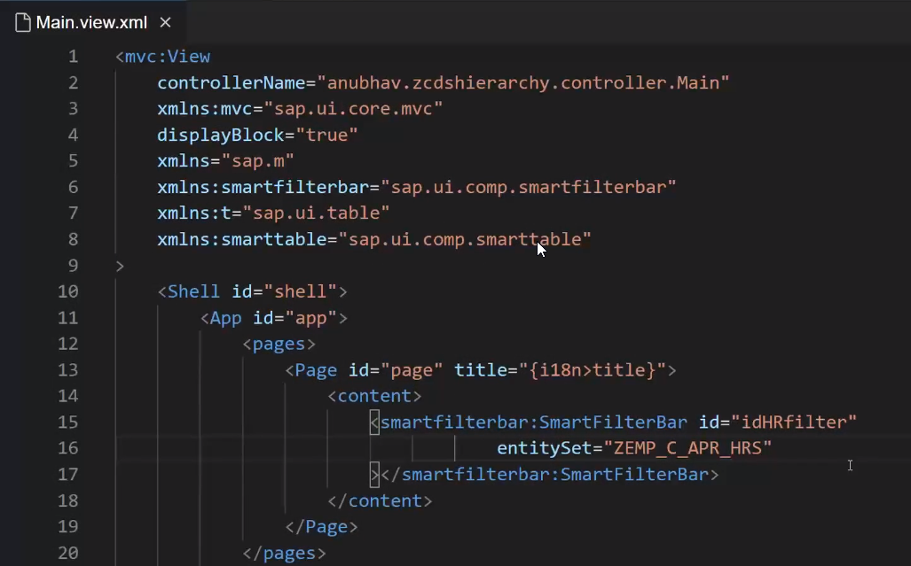
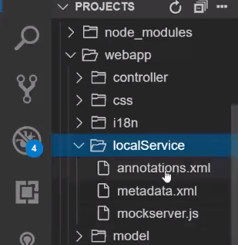
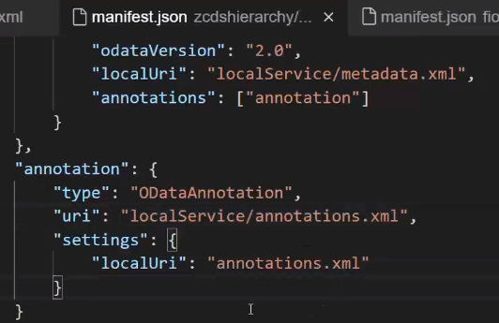
Creating Fiori app on top of CDS
2. Create and add Annotation file in our project.
1. To show All Data in Fiori App we Define or set the Entityset name in XML View.
3. Link annotation file use this code in Manifest.json.

Slide 11
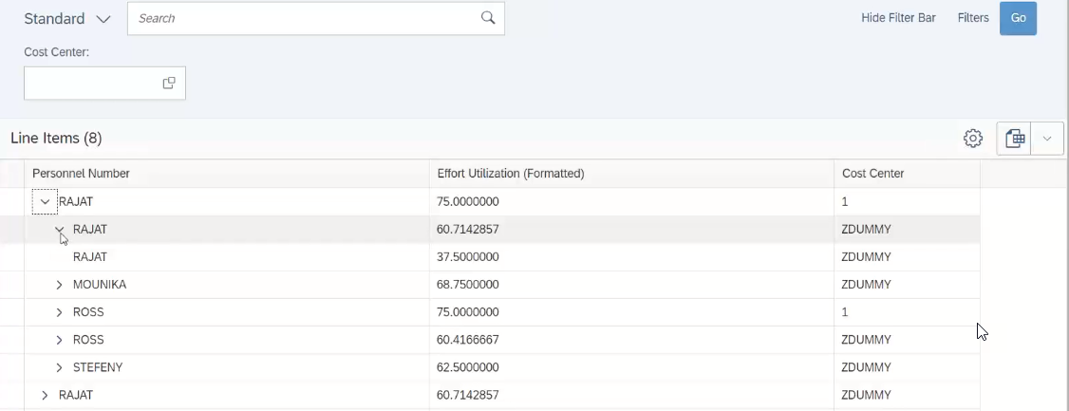
Result Employee Manager Hierarchy
UI Code for Hierarchy Scenario
Final output Employee Manager (Node under Node).

Slide 12
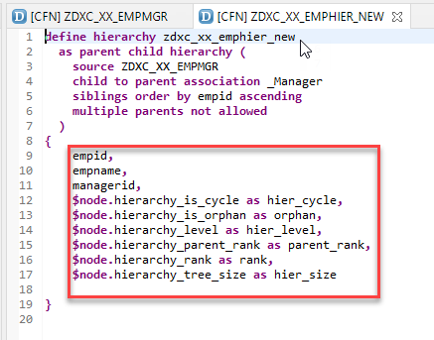
New Hierarchy
Hierarchical data is defined as data sets combined with each other via hierarchical relation. Hierarchical relations exist when one data item is positioned as parent of another item. New Hierarchy Syntax: -
Exercise :-
New Hierarchy Code

Slide 13

End of Day 15
Trainer: Anubhav Oberoy

Slide 14

Trainer: Anubhav Oberoy

Slide 15
THANK YOU
If you cannot do
great things, do small things in a great way.
Anubhav Oberoy
https://www.anubhavtrainings.com

Slide 16


We’re committed to empower you to be
Most Desirable Resource
through powerful training solutions.
We build the workforce of the future.
250+
Corporate Clients
30,000+
Learners Trained
25000+
Learners Placed
FREE WEBINARS
Sign up for free webinars with industry experts every fortnight!
Enroll Now!
Contact us today!
https://anubhavtrainings.com/

Slide 17




More from AnubhavTrainings.com

